Slide 1
Lecture 7.1 – Properties of Acids/Bases

Slide 2
Today’s Learning Targets
6.1 – I can describe the common properties of acids, bases, and salts. I can distinguish them based on taste, texture, ability to conduct electricity, and other observable properties.
6.2 – I can describe what an acid and base are using the idea of hydrogen ion donation and hydrogen ion accepting.
6.3 – I can characterize a compound as either a strong acid/base or weak acid/base based on how much it dissociates.

Slide 3
What are acids and bases?

Slide 4
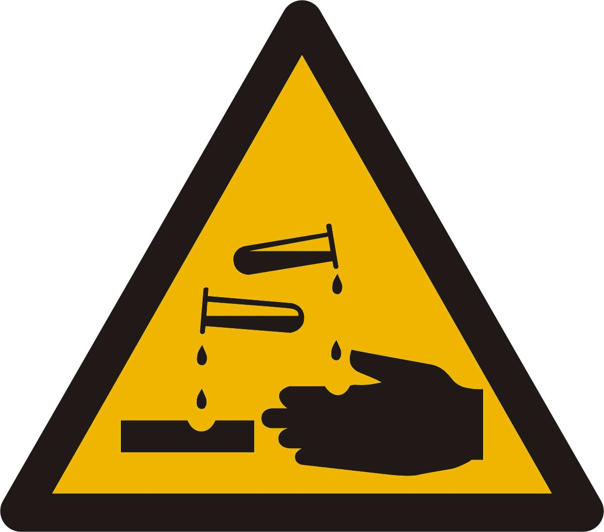
I. Acids and Bases
Acids and bases are a type of compound
Acids react with bases to produce a salt in a neutralization reaction

Slide 5
II. Conducting Electricity
When you dissolve an ionic compound in a solution it breaks into ions.
This positive and negative charge allows for the solution to now conduct electricity.
HCl → H⁺ + Cl⁻
Allow for it to conduct electricity!
Notes:
Use the wires, battery and nail set up to have students recall that covalent molecules do not conduct and ionic compounds do conduct

Slide 6
II. Conducting Electricity
You need charges to conduct electricity.
IONIC compounds conduct electricity and COVALENT compounds do not!

Slide 7
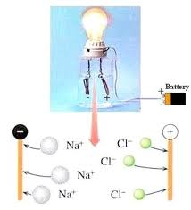

Slide 8
What are properties of acids and bases?

Slide 9
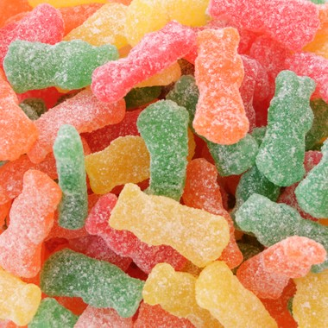
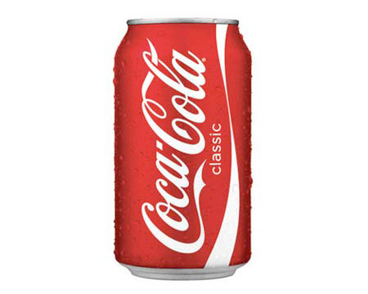
I. Common Properties of Acids
Sour
Conduct an electrical current
React with a base to form a salt
Turn blue litmus paper red
Most contain hydrogen in its chemical structure

Slide 10
II. Common Properties of Bases
Taste bitter
Dilute bases feel slippery
React with an acid to produce a salt
Turn red litmus paper blue
Bases conduct an electrical current
Most contain OH⁻

Slide 11
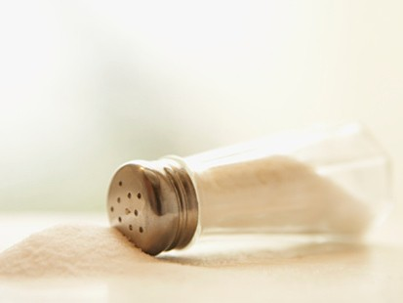
III. Common Properties of Salts
Ionic compound (contains an anion and cation)
Forms when an acid and base react in a neutralization reaction.
Conduct electricity

