Slide 1

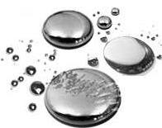
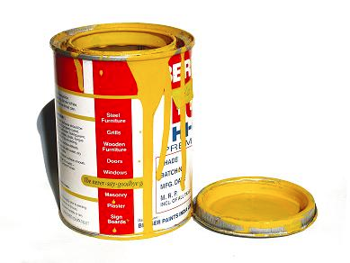
Lecture 1.1 – Introduction to the Atom

Slide 2
How do chemists characterize the atom?

Slide 3
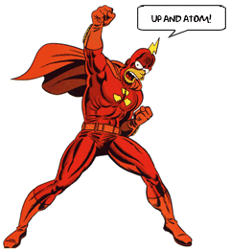
I. Size of the Atom
The atom has a diameter between 0.1 – 0.5 nm
Point of reference: A basketball has a diameter of 234,500,000 nm

Slide 4
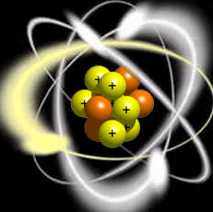
II. Three Types of Subatomic Particles
All atoms contain the following subatomic particles:
  Protons
  Neutrons
  Electrons

Slide 5
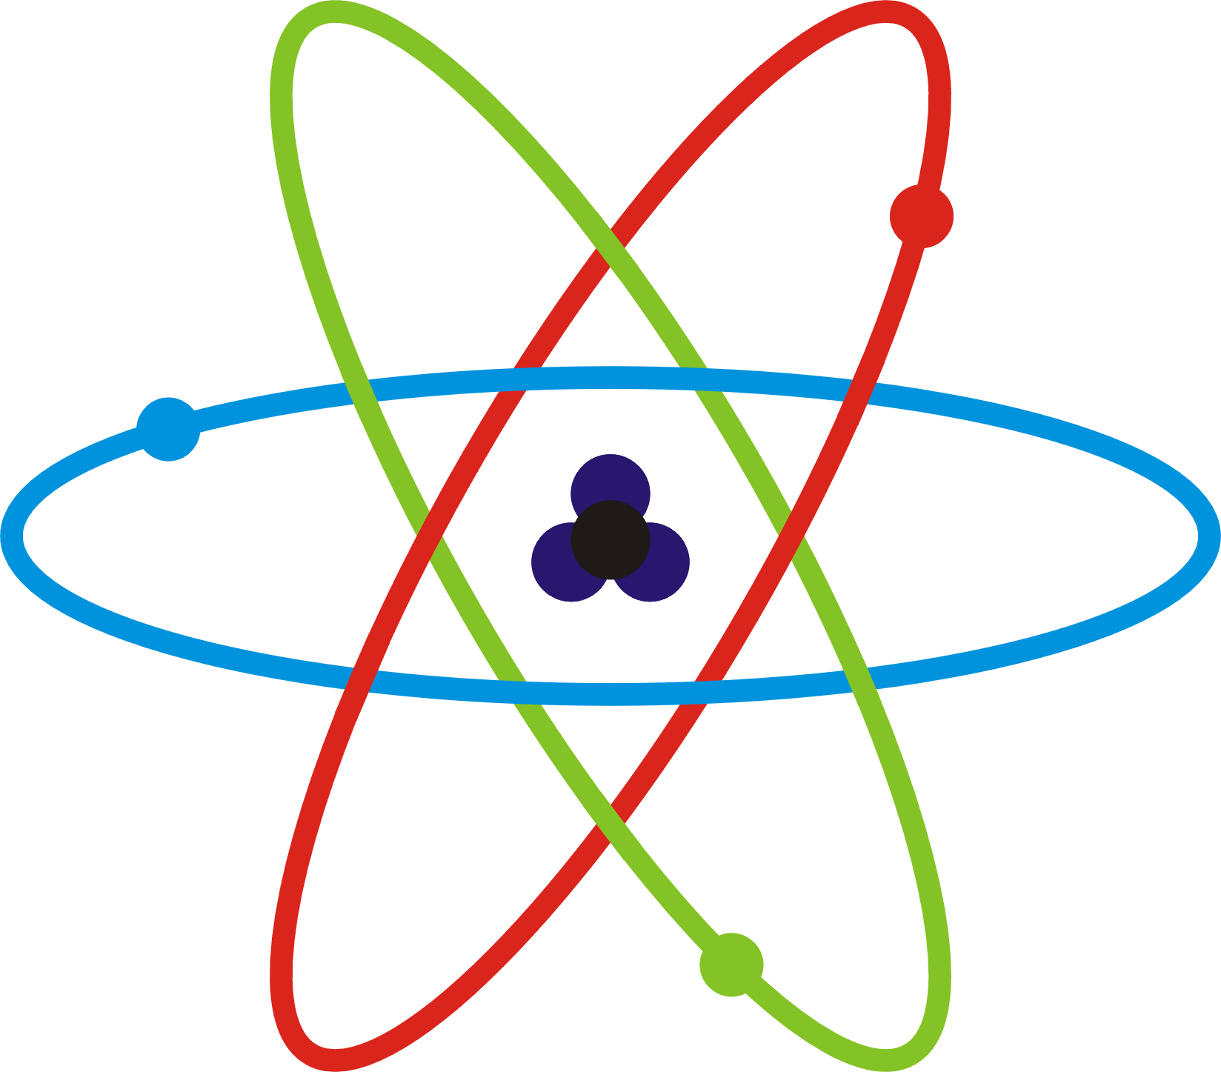
III. Protons
Protons are found in the nucleus of an atom.
The nucleus is located in the center of the atom.
Protons have a positive charge. We say that their charge is +1

Slide 6
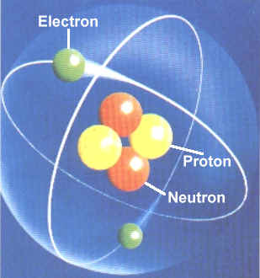
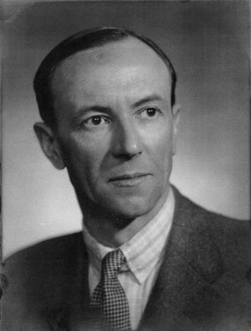
IV. Neutrons
Neutrons are found in the nucleus of an atom.
Neutrons do not have a charge. They are neutral
James Chadwick discovered the neutron in 1932!

Slide 7
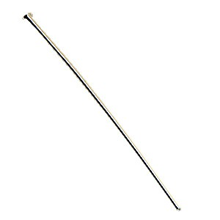
V. Mass of Protons and Neutrons
Protons and neutrons have the same mass.
Each subatomic particle has a mass of 1 amu.
  amu = atomic mass unit
Notes:
A typical sewing pin has over 5 million atoms on the top of its head.

Slide 8
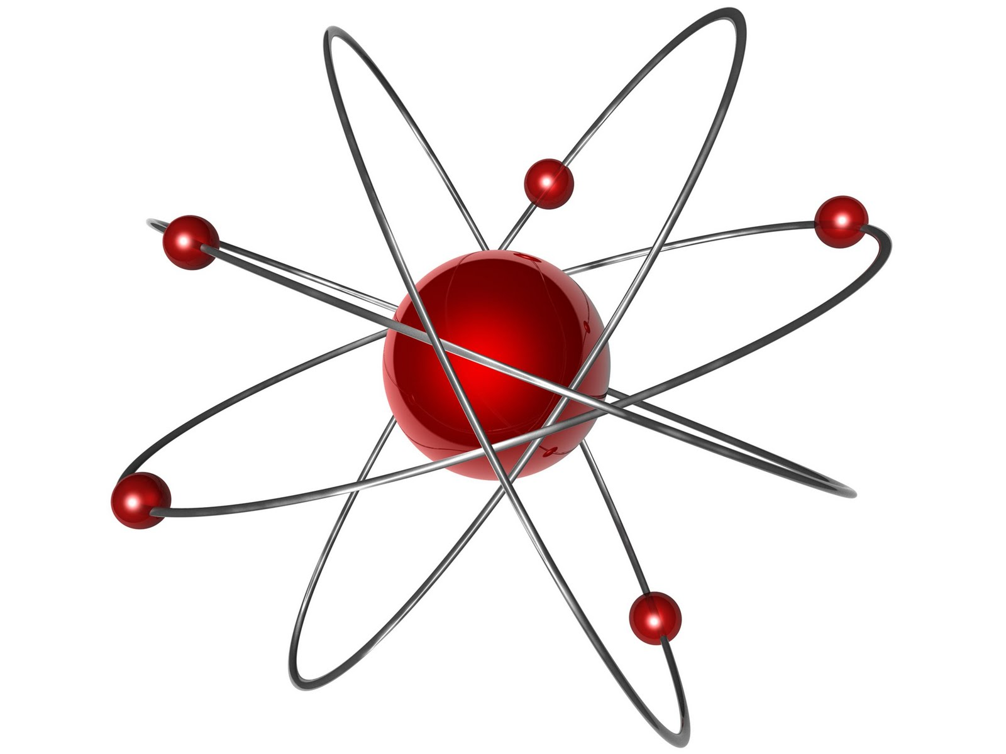
VI. Electrons
Electrons are found in the electron cloud.
The electron cloud surrounds the nucleus of an atom.
Electrons have a -1 charge

Slide 9
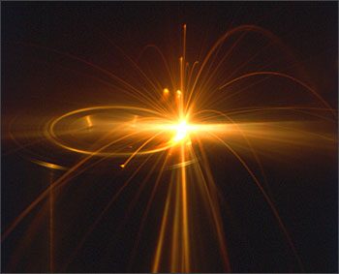
VII. Mass of Electrons
Electrons have a mass that is 0.00054 amu.
Electrons do not contribute to the weight of an atom.

